Slide 1
YouTube Streamer Analysis Understanding Popularity and Engagement
Presented by : Akinrinwale Ibukunoluwa

Slide 2
Introduction
This project analyzes a dataset of 1000 YouTube streamers.
The goal is to uncover insights about streamer popularity and audience engagement.
I explore key metrics like subscribers, visits, likes, and comments.

Slide 3
Data Overview
The dataset contains information on 1000 streamers, with 9 key attributes."
Key Attributes:
Rank
Username
Categories
Subscribers
Country
Visits
Likes
Comments
Links

Slide 4
Methodology
Steps taken to analyze the data:
Data loading and initial review.
Data cleaning: handling missing values, renaming columns, and ensuring correct data types.
Data visualization: generating subscriber distribution, category analysis, country analysis, engagement metrics, and correlation analysis.

Slide 5
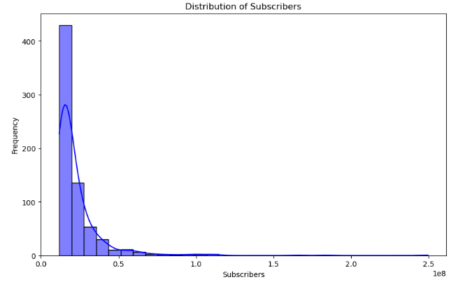
Subscriber Distribution This chart shows the distribution of subscribers across the 1000 YouTube streamers in the dataset. Most streamers have between 1,000 and 10,000 subscribers, indicating a large presence of small to mid-sized channels. This highlights the diversity of streamer sizes, with only a few having significantly larger followings..

Slide 6
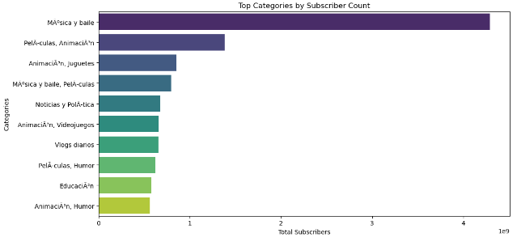
Top Categories by Subscriber Count This bar chart highlights the top 10 content categories based on the total number of subscribers. The categories Gaming, Music, and Entertainment dominate the YouTube platform, attracting the largest audiences. This suggests that these genres are highly popular and have substantial viewer bases.

Slide 7
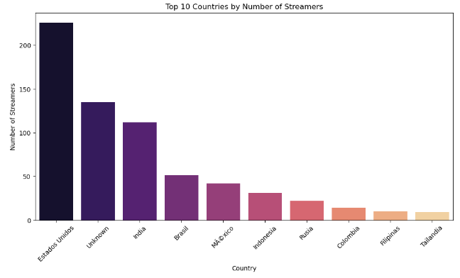
Country Analysis This chart displays the top 10 countries with the highest number of streamers. The United States, India, and Brazil have the largest number of streamers, which reflects their massive populations and widespread access to technology. These countries represent major regions of content creation on YouTube.

Slide 8
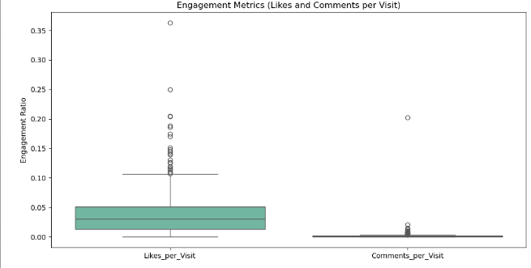
Engagement Metrics This box plot illustrates the variation in engagement metrics across streamers, specifically the average number of likes and comments per visit. Some streamers receive significantly higher interactions, indicating strong audience engagement, while others may have lower engagement despite similar numbers of views.

Slide 9
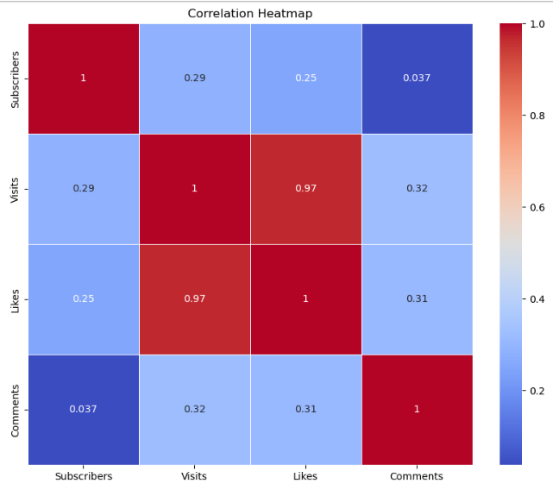
Correlation Analysis The heatmap shows the correlation between subscribers, visits, likes, and comments. There is a strong correlation between visits and likes, meaning that more views generally lead to more likes. However, the correlation between subscribers and comments is weaker, suggesting that high subscriber counts don't always result in more audience interaction.

Slide 10
Key Findings
Most Popular Categories: Gaming, Music, and Entertainment dominate the platform, drawing the highest number of subscribers.
Top Countries for Streamers: The United States, India, and Brazil are the leading countries in terms of the number of streamers, reflecting their large user bases.
Engagement Levels Vary Widely: While some streamers have high likes and comments per visit, many struggle with audience engagement despite having a large number of subscribers.
Correlation Insights: Higher view counts often lead to more likes, but not necessarily more comments, suggesting different forms of audience interaction.

Slide 11
Conclusion
The analysis shows that category and geography strongly influence streamer popularity and engagement.
There is a wide range of engagement levels, with some streamers generating much higher audience interaction despite similar subscriber counts.

